Slide 1
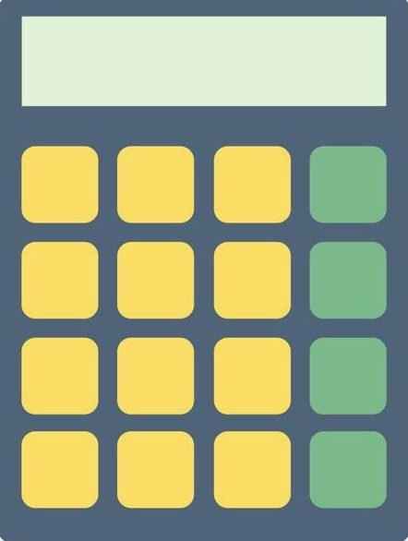
ADVANCED MULTIFUCTIONAL CALCULATOR USING PYTHON
One Application, Four Powerful Calculators
Project Presentation
Next Hikes IT Solutions
Presented By : Shubham Tiwari

Slide 2
Introduction
This is a Python-based multi-functional calculator application developed using Tkinter. It is designed to perform different types of mathematical and statistical calculations through a single, user-friendly interface.
The application combines four major calculator modes:
1. Normal Calculator
2. Scientific Calculator
3. Statistical Calculator
4. Health Calculator
The main objective of this calculator is to make calculations easier, faster, and more convenient by bringing multiple calculation tools into one application.

Slide 3
Technologies Used
1. Python
- Main programming language used to develop the application.
- Handles calculations and application logic.
2. Tkinter
- Used to create the Graphical User Interface (GUI).
- Provides buttons, tabs, input fields, and display screens.
3. Matplotlib
- Used for statistical data visualization.
- Helps generate Line Graphs and Scatter Plots.
4. Math Library
- Supports scientific and mathematical operations.
- Used for trigonometric functions and logarithmic calculations.
5. Statistics Library
- Used to perform statistical calculations and data analysis.

Slide 4
Key Features
* Multi-Functional Calculator: Combines four different calculator modes in one application.
* Normal Calculator: Performs basic arithmetic operations such as addition, subtraction, multiplication, and division.
* Scientific Calculator: Supports advanced mathematical functions, trigonometric calculations, logarithms, and degree/radian modes.
* Statistical Calculator: Performs statistical analysis and calculations using Data X and Data Y.
* Graphical Visualization: Generates Line Graphs and Scatter Plots for better data representation.
* Health Calculator: Calculates BMI, BMR, daily calorie requirements, and ideal weight.
* User-Friendly Interface: Provides an easy-to-use graphical interface with organized tabs.
* Keyboard Support: Allows users to perform calculations using laptop keyboard inputs.

Slide 5
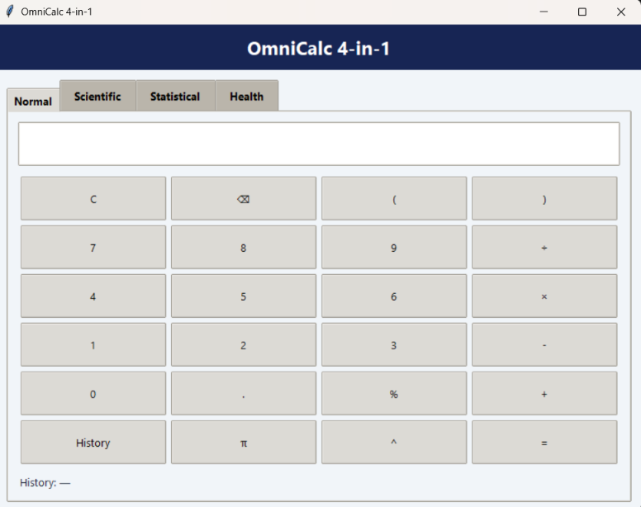
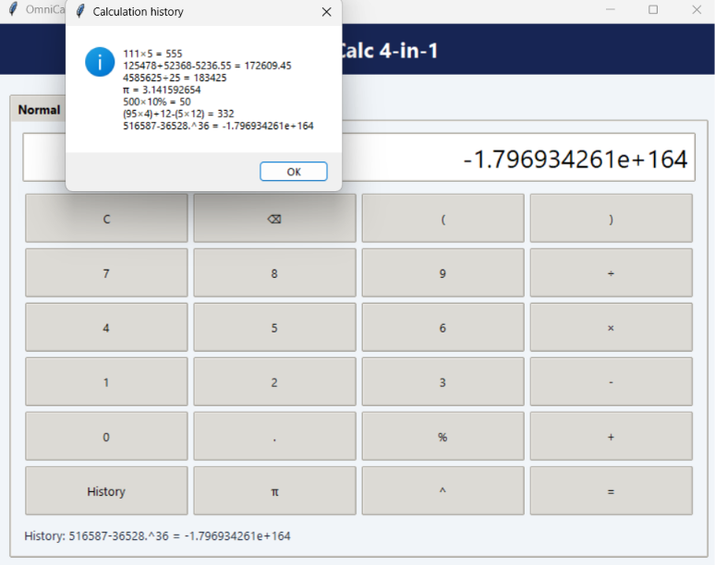
Normal Calculator
Features
* Performs basic arithmetic operations.
* Supports Addition, Subtraction, Multiplication, and Division.
* Includes Clear (C) functionality.
* Includes Calculation History Tab.
* Supports keyboard input.
* Provides a simple and user-friendly interface.
Purpose
To perform everyday mathematical calculations quickly and easily.

Slide 6
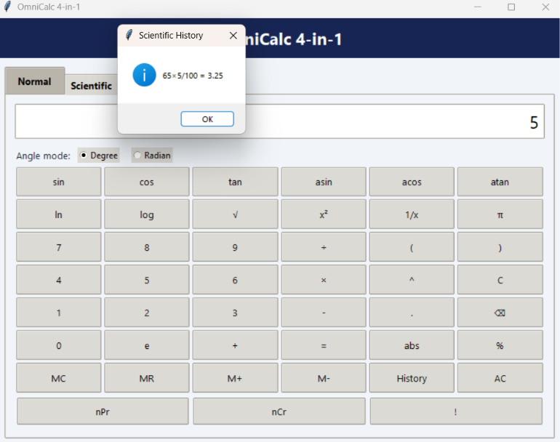
Scientific Calculator
Features
* Supports basic and advanced mathematical calculations.
* Provides trigonometric and inverse trigonometric functions.
* Supports Degree and Radian modes.

Slide 7
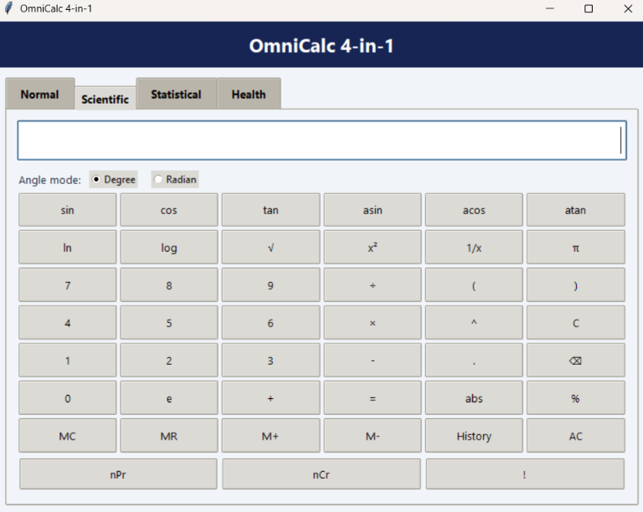
Function & Use
! | Calculates factorial (if supported in the expression)
nPr| Calculates permutations (if implemented)
nCr| Calculates combinations (if implemented)
M+| Adds the displayed value to memory
M-| Subtracts the displayed value from memory
MR| Recalls the stored memory value
MC| Clears the stored memory
e| Inserts Euler's number (2.71828...)
abs| Returns the absolute value of a number
^| Performs power or exponent calculation
x²| Calculates the square of a number
1/x| Calculates the reciprocal of a number

Slide 8
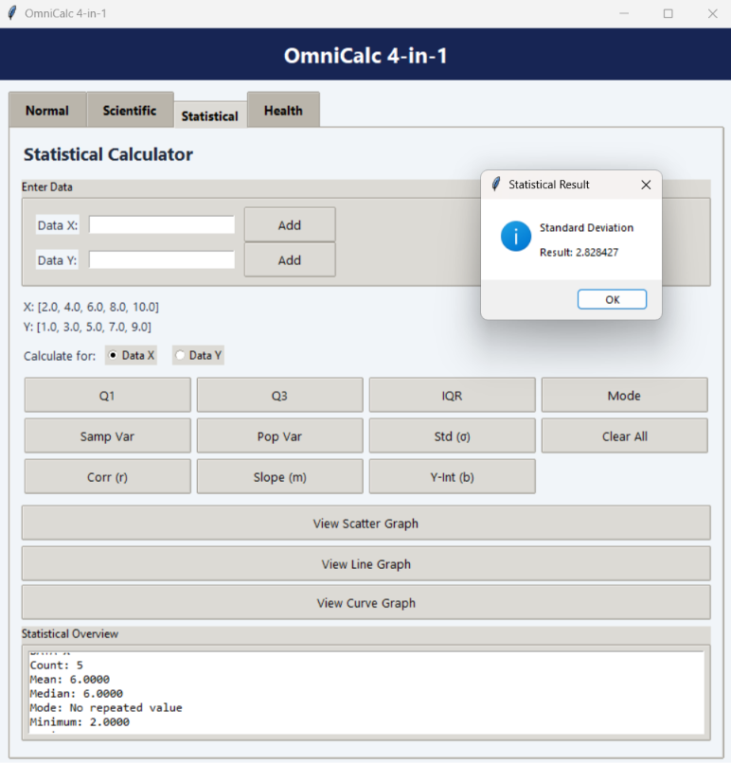
Statistical Calculator
The Statistical Calculator helps users perform statistical analysis on numerical datasets (Data X and Data Y).
Function & Use
Q1| Calculates the First Quartile (25th percentile).
Q3| Calculates the Third Quartile (75th percentile).
IQR| Calculates the Interquartile Range (Q3 − Q1).
Mode| Finds the most frequently occurring value.
Samp Var| Calculates Sample Variance.
Pop Var| Calculates Population Variance.
Std (σ)| Calculates Population Standard Deviation.
Corr (r)| Measures the correlation between Data X and Data Y.
Slope (m)| Calculates the slope of the regression line.
Y-Int (b)| Calculates the Y-intercept of the regression line.

Slide 9
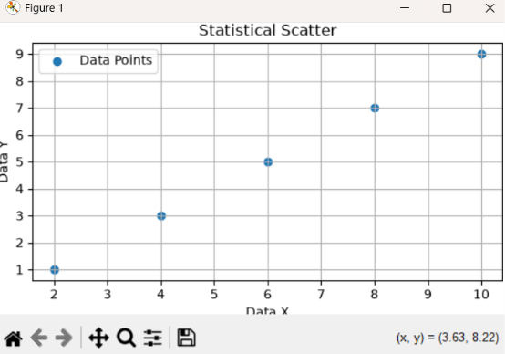
Graph
View Scatter Graph| Displays a scatter plot of Data X and Data Y.
View Line Graph| Displays a line graph of Data X and Data Y.
Features:
* Supports two datasets: Data X and Data Y
* Calculates important statistical measures
* Provides correlation and linear regression calculations
* Displays graphical representations of data
Offers a simple and user-friendly interface

Slide 10
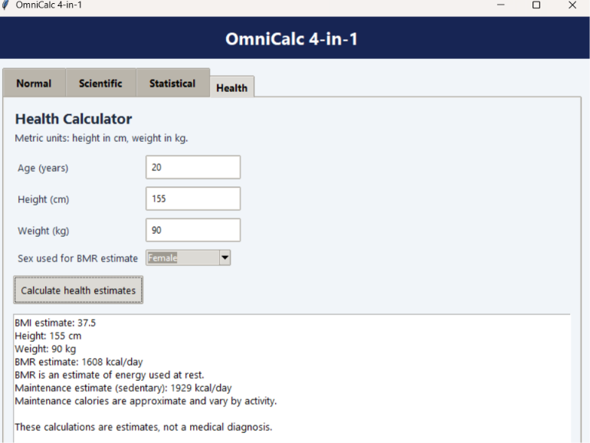
Health Calculator
The Health Calculator helps users calculate important health-related measurements using personal input values.
Function & Use
* BMI| Calculates Body Mass Index using height and weight.
* BMR| Estimates Basal Metabolic Rate (energy used by the body at rest).
* Calories| Estimates daily calorie requirements.
* Ideal Weight| Provides an estimated healthy weight range based on height.
* Metric Units| Allows users to enter height in centimetres and weight in kilograms.
* Both Units| Supports different measurement units, if available in the calculator.

Slide 11
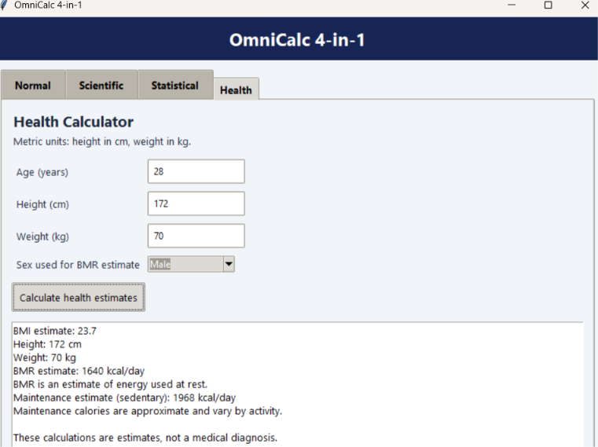
Features:
* Simple health-related calculations
* Easy height and weight input
* Supports metric measurements
* Displays calculated results instantly
* User-friendly graphical interface
Note: BMI and other results are estimates, not medical diagnoses.

Slide 12
Challenges
1. Graph Functions: Creating Scatter and Line Graphs.
2. Matplotlib Installation: Installing and configuring the library.
3. Button Alignment: Proper arrangement and spacing of calculator keys.
4. Scientific Calculator: Identifying and fixing missing features after testing.
5. Error Handling: Finding and debugging coding errors.
6. Keyboard Functionality: Preventing duplicate inputs while using laptop keys.
7. Code Integration: Combining Normal, Scientific, Statistical and Health calculators into one application without affecting each other's functions.

Slide 13
Conclusion
This project helped me improve my knowledge of Python programming, GUI development, mathematical operations, data analysis and problem-solving.
Overall, this all in one calculator provides a simple, user-friendly and efficient calculation experience through a single application.

Slide 14
Thank You

